Slide 1
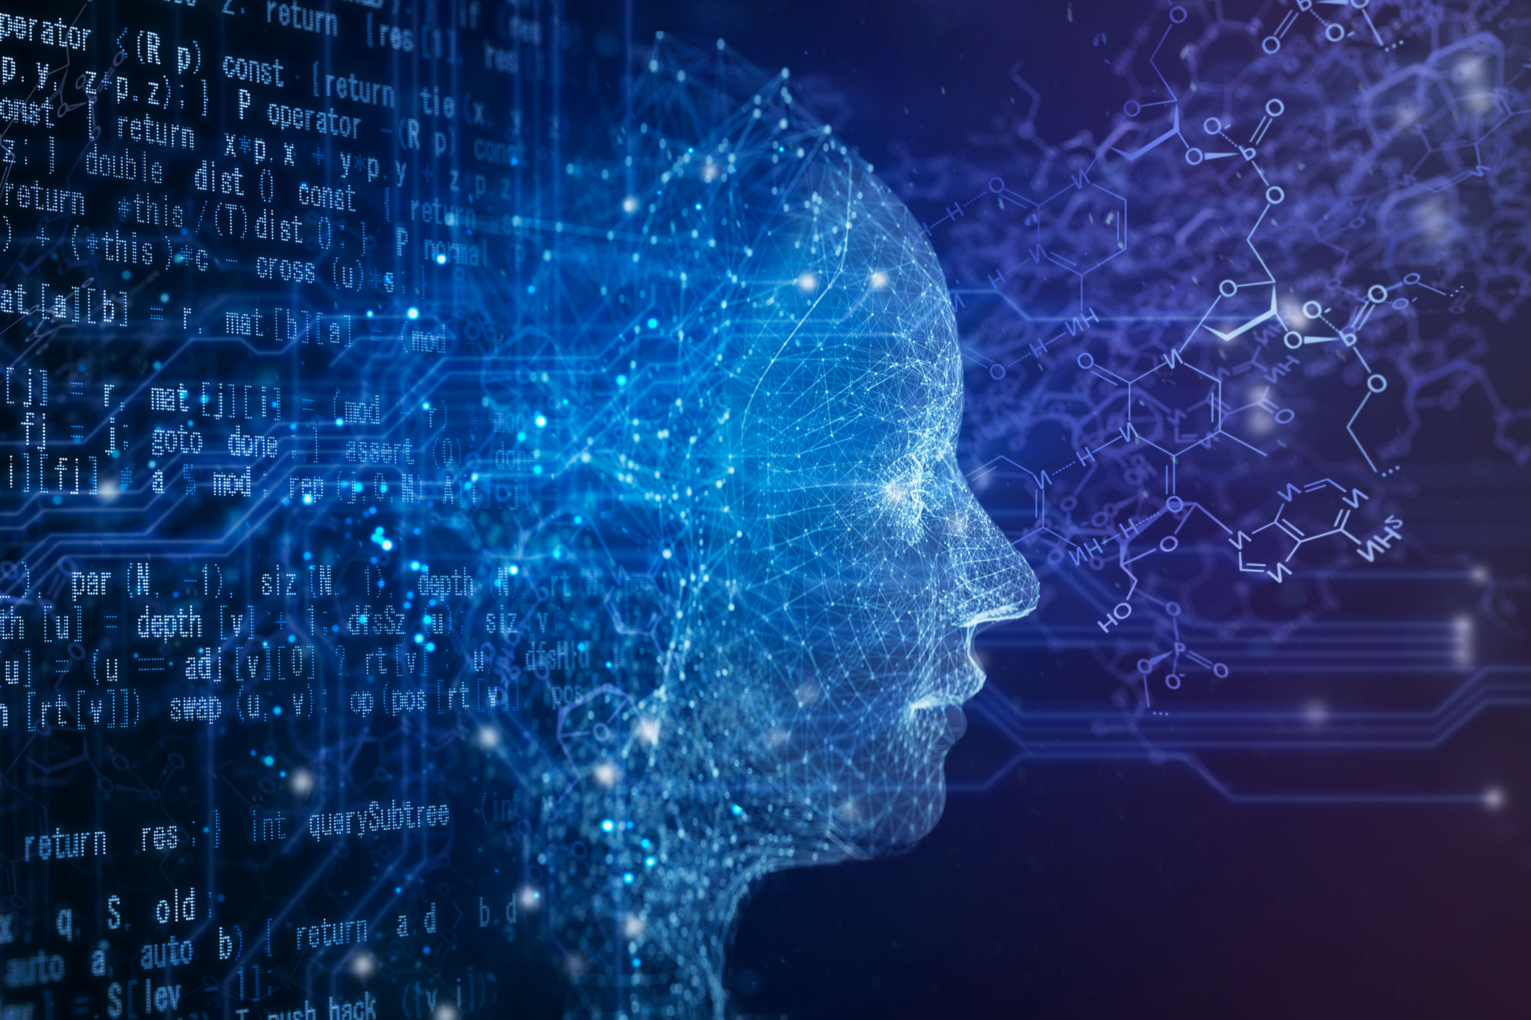
Desktop AI Assistant
DETROIT: DESKTOP
ASSISTANT
Here is where your presentation begins

Slide 2
Problem Statement:
Users often waste time on repetitive task and performing routine system maintenance. ‘Task Automation’ is a major trend in the modern day world. The modern day user finds it a tedious task to use different applications to perform different tasks.

Slide 3
Solution:
We have designed and developed a VOICE-CONTROLLED desktop assistant capable of efficiently executing a wide range of tasks such as
Opening Google and YouTube, also to download a video from YouTube
Showing the Latest News
Tells the current weather of your city
Setting an alarm
Setting a reminder

Slide 4
Techstack:
Python and it’s various libraries such as
Pyttsx3
speech_recognition
Winsound
Pyaudio
Webbrowser
Plyer
Time
Requests
Os
pytube
datefinder
datetime

Slide 5
Architecture of the idea
Speech RecognitionModule
Voice Input
Voice Assist
API Calls
Python Backend
Text To Speech Module
Performs the task
Content Extraction

Slide 6
How the Idea is Unique:
Customization
Task Automation
Voice Recognition Accuracy
Seamless Integration with other applications
User-Centric

Slide 7
THANK YOU MADE BY-Aakash Pathak Aaditya Varshney Aditya Ghatia Priyanshu Tiwari

